Slide 1


Autonomously Navigating E-Rickshaw using Global and Local Navigation
Presented by:
Shreyas Tripathi (Electronics Engg.)
Karthik Anand (Electronics Engg.)

Slide 2
Contents
Motivation and Objectives
Overview
Approach/Methods
Social Impact
Progress Made
References

Slide 3
Motivation
Motivation:
1. reduce road accidents : approx. 5 lakh accidents every year (officialy)
2. free up large amount of parking spaces
3. reduce the problem of traffic
4. decrease carbon emissions
5. conserve fuel

Slide 4
Objectives
Provide autonomous and global navigation for autonomously navigating e-rickshaw
use global path planning to get an optimal path to a destination
local path planning to avoid obstacles on the road and manoeuvre the vehicle properly on crowded roads
The global path planning makes use of GPS data and network analysis tool to search for an optimal route by a certain frequency.
The data from the cameras is used for local path planning which is fed to a convolutional neural network (CNN) to map raw pixels to steering commands.

Slide 5
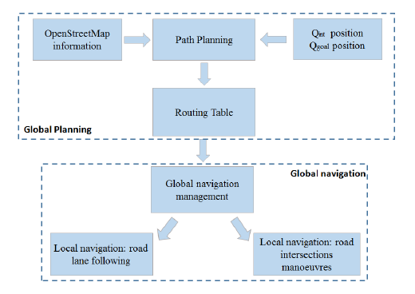
Overview

Slide 6
Approach/Methods:Global Navigation
We build two GPS databases, comprising a GIS database and a special route database.
The GIS database stores the general road GPS data and the special route database stores the GPS data of the route
We search a route through the road network and build the network analysis tool of the ArcGIS Engine-interface of INASolver

Slide 7
Local Navigation
Three cameras are mounted behind the windshield of the data-acquisition e-rickshaw. Time-stamped video from the cameras is captured simultaneously with the steering angle applied by the human driver
train a convolutional neural network (CNN) to map raw pixels from a single front-facing camera directly to steering commands
This steering command is obtained by tapping into the vehicle’s Controller Area Network (CAN) bus.
In order to make our system independent of the car geometry, we represent the steering command as 1/r where r is the turning radius in meters.
We will use an NVIDIA DevBox and Torch 7 for training and an NVIDIA DRIVETM PX self-driving car computer also running Torch 7 for determining where to drive

Slide 8
Training Data Set
Training data contains single images sampled from the video, paired with the corresponding steering command (1/r).
We sample that video at 10 FPS. A higher sampling rate would result in including images that are highly similar.
Training data includes a higher proportion of frames that represent road curves.
We augment the data by adding artiﬁcial shifts and rotations to teach the network how to recover from a poor position or orientation.

Slide 9
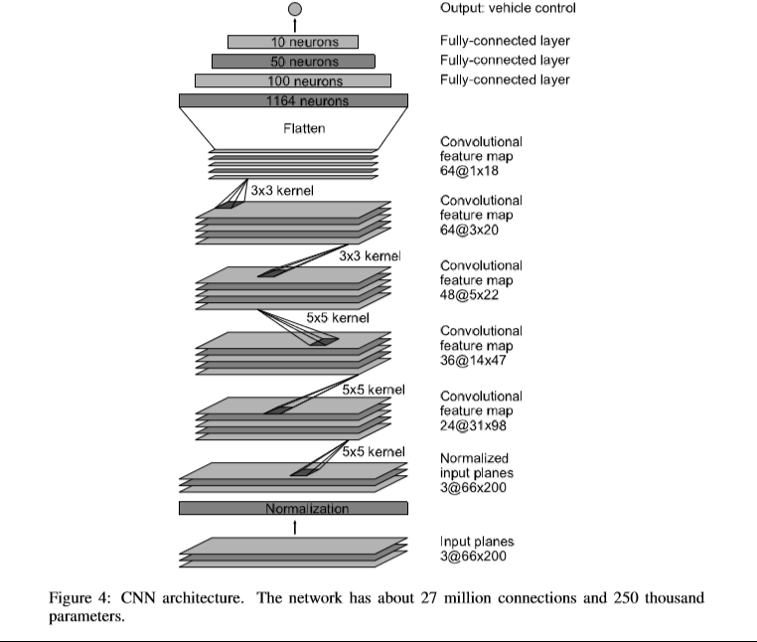
Architecture
9 layers, including a normalization layer, 5 convolutional layers and 3 fully connected layers
ﬁrst layer of the network performs image normalization
The convolutional layers were designed to perform feature extraction
The ﬁve convolutional layers with three fully connected layers leading to an output control value which is the inverse turning radius
. The fully connected layers are designed to function as a controller for steering.

Slide 10
Social Impact
Stakeholders- Automobile industry, driver community, academia, public.
Institutional Arrangements- Fully- equipped labs, servers for processing big-data, high-quality cameras and sensors.
Social risks- Acceptance by the Government, acceptance by the public and the industry

Slide 11
Till Now:
Dataset was recorded while vehicle was driven by human.
A small-scale prototype for driving model was prepared using microprocessor “Raspberry pi” with RTos implemented
Driving model using single camera is prepared by mimicking human decision-making approach for efficient and autonomous driving.
Basic algorithm has been implemented for PoC.

Slide 12
References
Mariusz Bojarski , Davide Del Testa , Daniel Dworakowski , End to End learning for Self-Driving cars , Nvidia
Sebastian Thrun. “Path Planning for Autonomous Vehicles in Unknown Semi-structured Environments”.
Kaijun Zhou. “Local Path Planning of Driverless Car Navigation Based on Jump Point Search Method Under Urban Environment”.

Slide 13
Thank You

